Slide 1

THE INSTITUTE OF FINANCE MANAGEMENT
FACULTY OF ACCOUNTING, BANKING AND FINANCE
DEPARTMENT OF ACCOUNTING AND FINANCE
BACHELOR OF ACCOUNTANCY
YEAR 3
STREAM B
MSU08502:ENTREPENUERSHIP
ACADEMIC YEAR 2023/2024
S/N | NAME | REGISTRATION NUMBER
1. | ABBA J MWASONGWE | IMC/BAIT/2121299
2. | LUIS BENEDICT | IMC/BAIT/2121052
3. | IBRAHIM KISHEGENA | IMC/BAIT/2011107

Slide 2
Construction of business venture
REUSABLE SANITARY PADS (SANITARY TOWEL)

Slide 3
BUSINESS MODEl: REUSABLE SANITARY PADS (SANITARY TOWEL)
Business model refers to a plan for the successful operation of a business, identifying sources of revenue, the target customer base, products, and details of financing.
In summary, a good business model should define, Who the target customer is, What the customer wants, How the company makes money while delivering value.
Reusable sanitary pads is helpful to both women and girls since uses sanitary pads each month. Most of them use disposable sanitary pads, which is not friendly to the health of women and girls. Therefore establishing the business of reusable sanitary pads it’s an advantage since its friendly to women health and they can be used more than once. there are determined to provide all Tanzanian girls and women access to affordable reusable sanitary pads, with the major aim of avoiding the unhygienic and uncomfortable methods applied by a good number of girls and women on their menstruation that have far reaching implications for the well being of many women and adolescent girls in Tanzania. The pads are of high quality , comfortable, absorbent and no leakage when they are changed regularly (every 4- 6 hours) just as it is with disposable pads. The pads are washable thus reusable, lasting for at least one year. The 3 -packs come with an easy to understand manual (in pictures) on how to handle the washing and drying of the pads.

Slide 4
COMPONENTS OF A BUSINESS MODEL
Customer segments
Value propositions
Channels
Customer relationships
Revenue streams
Key resources
Key activities
Key partnership
Cost structure

Slide 5
CUSTOMER SEGMENTS
It describes the portion of the market our business targets. Our product focus on female gender( women and adolescent girls in urban and rural areas found in Tanzania)

Slide 6
VALUE PROPOSITIONS
It defines the unique benefits our product is offering to our clients. And our business value propositions include reusable pads which are more health
super absorbent, easy to wash, good quality and are economic.

Slide 7
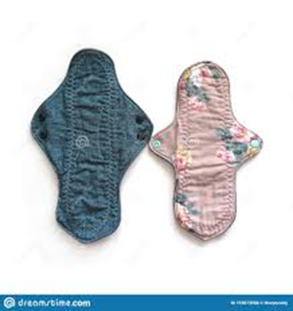
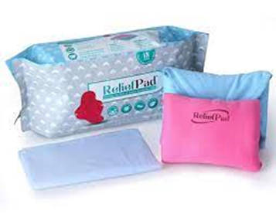
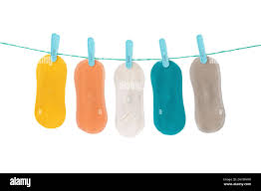
VALUE PROPOSITIONS

Slide 8
CHANNELS
Are means by which our customers come into contact with our business, our common customer channel includes own stores, wholesalers, partner stores, retail stores, social media, web sales, trade shows.

Slide 9
CUSTOMER RELATIONSHIPS
Customer relationships define the way we communicate with our clients. We do interact with our customers in person (provision of consultant), over the phone, online, by selling of reusable sanitary pads.

Slide 10
REVENUE STREAMS
Revenue streams represent all the ways our business brings in money. Our business generates revenue from the following sources in-store sales, subscriptions, advertising.

Slide 11
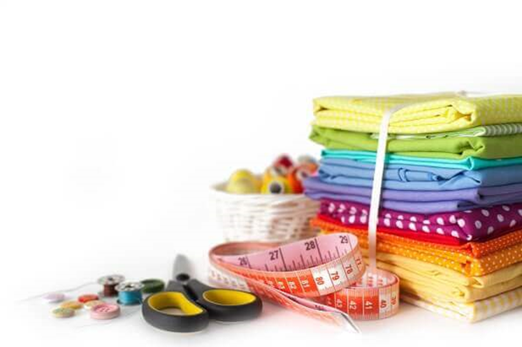
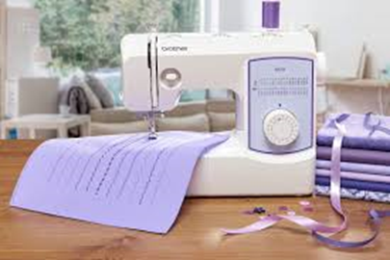
KEY RESOURCES
Key resources describes the most important assets required to make our business model work, our business includes the following key resources
Skilled tailors, Experienced and skilled tailors who can create and provide quality alteration and repair
Sewing equipments such as needles, sewing machines, scissors ,pv fabric buttons, towels, baby mats, threads, fleece cloth materials, pen and pencil, rulers.
Quality fabric. Use of high quality fabric that are comfortable, absorbent with no leakage when changed regularly ( after every 4-6 hours).

Slide 12
KEY ACTIVITIES
Key activities helps our business run efficiently enough to fulfill our business value and describes of activities in the value chain, our key activities in the value chain includes production and distribution of sanitary pads as well as consultations.

Slide 13
KEY PARTNERSHIP
The key partnerships describes the networks of suppliers and partners that makes our business work, our key partnerships includes super markets, medical stores, online markets, schools, orphanages centers, wholesalers and retail markets in local shops.

Slide 14
COST STRUCTURE
The cost structure describes all costs incurred to operate our business model, our cost structure includes
Variable cost( material cost, travel expenses):Material and fabric costs: expenses of buying fabric for material for making sanitary pads like needles, sewing machine, sicossor, pv fabric buttons, towels, threads.
Fixed cost( rent): cost for leasing or acquiring a physical store as well as utilities such as electicity, water
Labour cost: This includes wages and salaries of the skill tailor and any other staff employed focus on service and support

Slide 15
BUSINESS MODEL CANVAS: REUSABLE SANITARY PADS (SANITARY TOWEL)
Key Partners | Key Activities | Value Proposition | Customer Relationship | Customer Segment
super markets medical stores online markets schools orphanages centers wholesalers and retail markets in local shops | production and distribution of sanitary pads as well as consultations. | reusable pads which are more health super absorbent, easy to wash good quality and are economic. | in person(provision of consultant) over the phone online by selling of reusable sanitary pads. | female gender( women and adolescent girls in urban and rural areas found in Tanzania).

Slide 16
BUSINESS MODEL CANVAS: REUSABLE SANITARY PADS (SANITARY TOWEL)
Key Resources | Channels | Cost Structure | Revenue Stream
labour(human labours) needles sewing machines scissors pv fabric buttons towels baby mats threads fleece cloth materials pen and pencil rulers | ownstores wholesalers partner stores retail stores social media websales trade shows | variable cost( material cost,travel expenses) Fixed cost( rent). | in-store sales subscriptions advertising

Slide 17
REFERENCES.
Adelman, I. (1961). Theories of Economic Growth and Development. Stanford University Press, Stanford.
Ahmed, G. (2012). Krugman trade theory and developing economies. China-USA Business Review , 11(12), 1557-1564.
Tariq, M. (2019). Schumpeterian Entrepreneurship Theory: Evolution and relevance. Skyline University College, USA.
Schumpeter , J.A. (1912). The Theory of Economic Development, stanford University Press, 1969 (Reprint).

